Slide 1

Parameter Efficient Fine-Tuning (PEFT)
Sources:
* Matt Gormley slides for CMU’s Generative AI course.
* V. Lialin, V. Deshpande, and A. Rumshisky, “Scaling Dow to Scale Up: A Guide to Parameter-Efficient Fine-Tuning”, ArXiv 2023.

Slide 2

Few-shot Learning with LLMs
Suppose you have…
  a dataset D = {(x_{i}, y_{i})}_{i=1}^{N} and N is rather small (i.e. few-shot setting)
  a very large (billions of parameters) pre-trained language model There are two ways to “learn”
Option A: Supervised fine-tuning Option B: In-context learning
In this section, we consider the question:
How can we do supervised finetuning of a very large foundation model more efficiently?
Definition: fine-tune the LLM on the training data • Definition: using… 1.
feed training examples to the LLM as a prompt
allow the LLM to infer patterns in the training examples during inference (i.e. decoding)
take the output of the LLM following the prompt as its prediction
a standard supervised objective
backpropagation to compute gradients
your favorite optimizer (e.g. Adam)
Pro: fits into the standard ML recipe
Pro: still works if N is large
Con: backpropagation requires ~3x the memory and computation time as the forward computation
Con: you might not have access to the model weights at all (e.g. because the model is proprietary)
Con: the prompt may be very long and Transformer LMs require O(N²) time/space where N = length of context
Pro: no backpropagation required and only one pass through the training data
Pro: does not require model weights, only API access

Slide 3
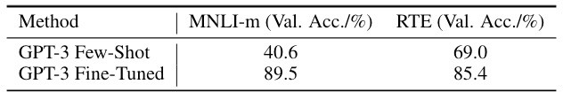
Fine-Tuning vs. In-Context Learning
Why would we ever bother with fine-tuning if it’s so inefficient?
Because, even for very large LMs, fine-tuning often beats in-context learning
Question:
Why did fine-tuning of GPT-3 do so much better on these two tasks than few-shot learning?
Source: http://arxiv.org/abs/2106.09685

Slide 4
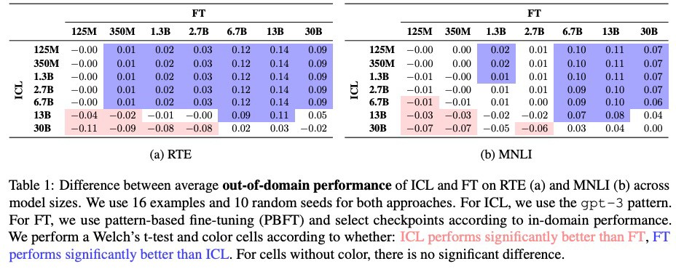
Fine-Tuning vs. In-Context Learning
Why would we ever bother with fine-tuning if it’s so inefficient?
Because, even for very large LMs, fine-tuning often beats in-context learning
In a fair comparison of fine-tuning (FT) and in-context learning (ICL), we find that FT outperforms ICL for most model sizes
Source: https://aclanthology.org/2023.findings-acl.779.pdf

Slide 5
Taxonomy of PEFT: A birds-eye view
PEFT methods
Additive methods
Adapters
Soft Prompts
Selective methods
Reparametrization-based methods
Hybrid methods
Notes:
Additive: Add additional parameters
Selective: Finetuning only a few layers
Reparameterization: Leverage low-rank representations to minimize the number of trainable parameters.

Slide 6
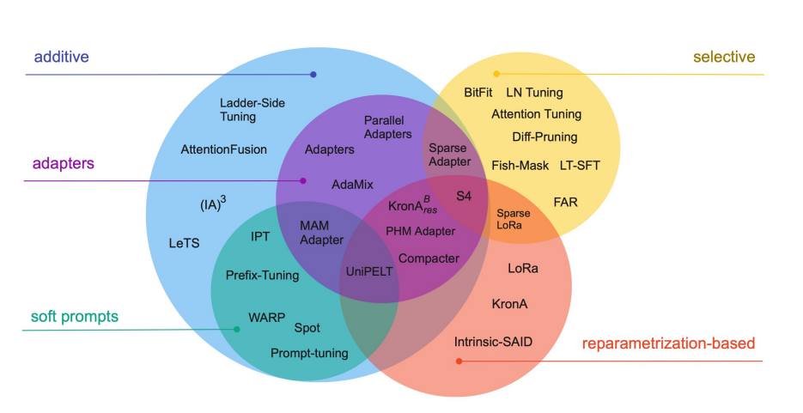
Taxonomy of PEFT: a birds-eye view

Slide 7
Comparing PEFT methods
5 Dimension of Comparison
Storage efficiency
Memory efficiency
Computation efficiency
Accuracy
Inference overhead

Slide 8
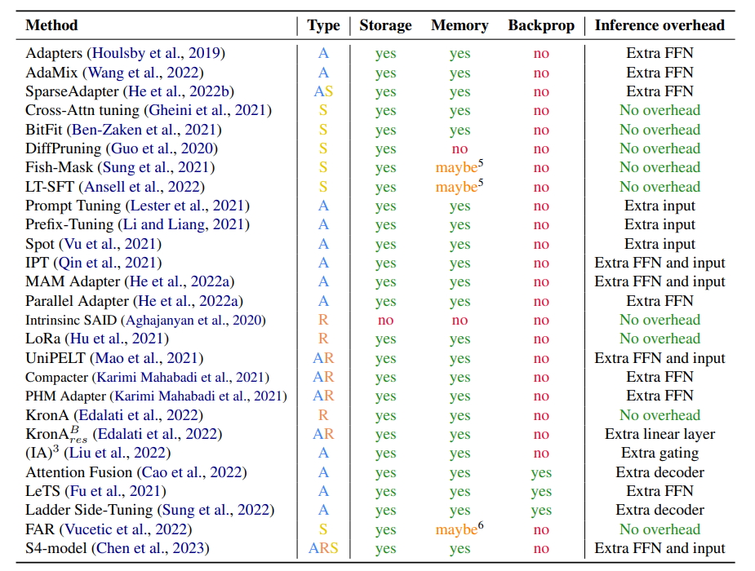

Slide 9
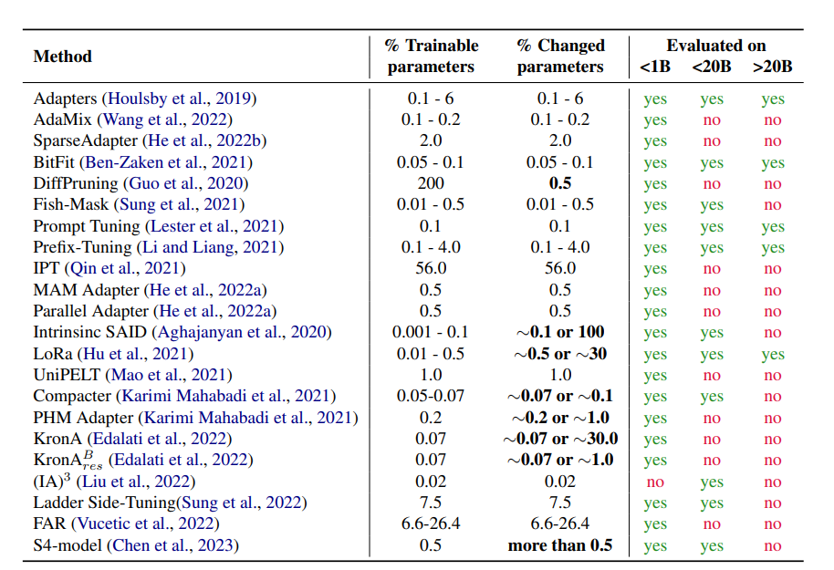
Overview of PEFT Approaches

Slide 10
Parameter Efficient Fine-Tuning
Goal: perform fine-tuning of fewer parameters, but achieve performance on a downstream task that is comparable to fine- tuning of all parameters
Various approaches:
  Prefix Tuning: for a Transformer LM, pretend as if there exist many tokens that came before your sequence and tune the keys/values corresponding to those tokens
  Subset: Pick a subset of the parameters and fine-tune only those (e.g. only the top K layers of a K+L layer deep neural network)
  Adapters: add additional layers that have few parameters and tune only the parameters of those layers, keeping all others fixed
  LoRA: learn a small delta for the each of the parameter matrices with the delta chosen to be low rank

Slide 11


Fine-Tuning the Top Layers Only
J = log p(w₁ | w₂ , w₃)
+
Simple baseline for PEFT:
  keep all parameters fixed except for the top K layers
  gradients only need to flow through K layers instead of K+L total layers
  reduced memory usage b/c we don’t need to store the adjoints (gradient of the loss with respect to each parameter) for the full computation graph
Can easily be applied to most deep neural networks
ℓ₁(·,·)
The
p(w₁|h₂)
h₁
h₂
h₃
h₄
stop gradient here
Transformer layer
s.t. error does not
backprop to lower
layers
Transformer layer
Transformer layer
x₁ x₂ x₃ x₄ [CLS] [MASK] cat sat

Slide 12
Adapters

Slide 13
Overview of PEFT Approaches (Adapters)
Add fully-connected networks after attention and FFN layers in Transformer.
Possible to achieve performance competitive to full fine-tuning by tuning less than 4% of the total model parameters.
Type | A | % Train | 0.1-6
Storage | Yes | % Change | 0.1-6
Memory | Yes | <1B | Yes
Backprop | No | <20B | Yes
Inf. Overhead | Extra FFN | >20B | Yes

Slide 14
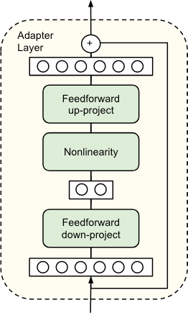
Adapters Module
An adapter layer is simply a feed- forward neural network with one hidden layer, and a residual connection
For input dimension, d, the adapter layer also has output dimension d, but bottlenecks to a lower dimension m in the middle
d
r
d
Figure from

Slide 15




Adapters for Transformer
X’
add & layer norm
In practice, m is chosen s.t. m << d and the adapter layers contain only 0.5% – 8% of the total parameters
When added to a deep neural network (e.g. Transformer) all the other parameters of the pretrained model are kept fixed, and only the adapter layer parameters are fine-tuned
adapter
feed-forward neural net
add & layer norm
adapter
transformer
attention
Q
K
V
multi-headed
⨉
⨉
⨉
W_{q}
W_{k}
W_{v}
X
Figure inspired by He et al. (2022)

Slide 16
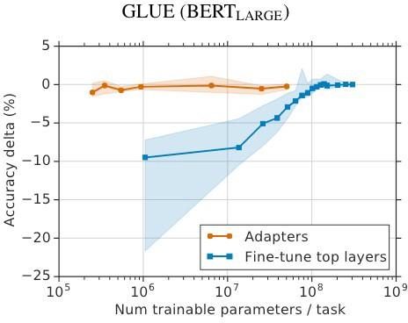
Adapter Results
Pretrained Model: BERT- Large
Baseline Method: fine- tune only the top K layers of BERT-Large
Adapters achieve nearly the performance (i.e. 0% delta) of full fine-tuning but with substantially fewer parameters
Sometimes adapters even outperform full fine-tuning

Slide 17
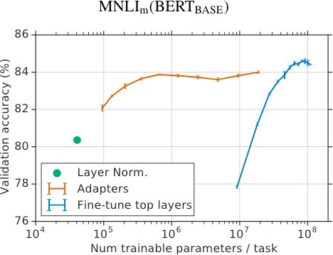
Adapter Results
Pretrained Model: BERT- Large
Baseline Method: fine- tune only the top K layers of BERT-Large
Adapters achieve nearly the performance (i.e. 0% delta) of full fine-tuning but with substantially fewer parameters
Sometimes adapters even outperform full fine-tuning

Slide 18
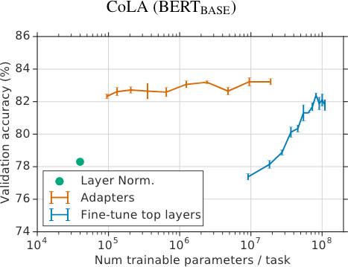
Adapter Results
Pretrained Model: BERT- Large
Baseline Method: fine- tune only the top K layers of BERT-Large
Adapters achieve nearly the performance (i.e. 0% delta) of full fine-tuning but with substantially fewer parameters
Sometimes adapters even outperform full fine-tuning

Slide 19
Low-Rank Adaptation (LoRA)

Slide 20
How large are LLMs?
Recall…
Comparison of some recent large language models (LLMs)
Model | Creators | Year of release | Training Data (# tokens) | Model Size (# parameters)
GPT-2 | OpenAI | 2019 | ~10 billion (40Gb) | 1.5 billion
GPT-3 (cf. ChatGPT) | OpenAI | 2020 | 300 billion | 175 billion
PaLM | Google | 2022 | 780 billion | 540 billion
Chinchilla | DeepMind | 2022 | 1.4 trillion | 70 billion
LaMDA (cf. Bard) | Google | 2022 | 1.56 trillion | 137 billion
LLaMA | Meta | 2023 | 1.4 trillion | 65 billion
LLaMA-2 | Meta | 2023 | 2 trillion | 70 billion
GPT-4 | OpenAI | 2023 | ? | ?

Slide 21
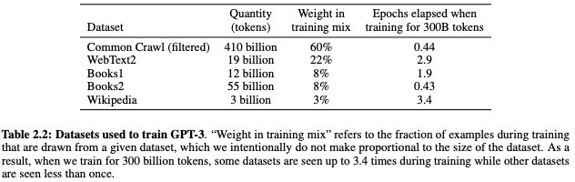
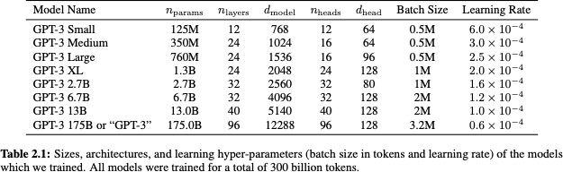
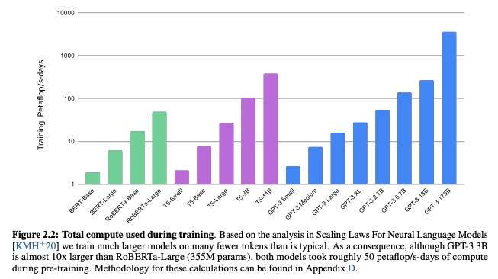
Why does efficiency matter?
Recall…
Case Study: GPT-3
  # of training tokens = 500 billion
  # of parameters = 175 billion
  # of cycles = 50 petaflop/s-days (each of which are 8.64e+19 flops)

Slide 22
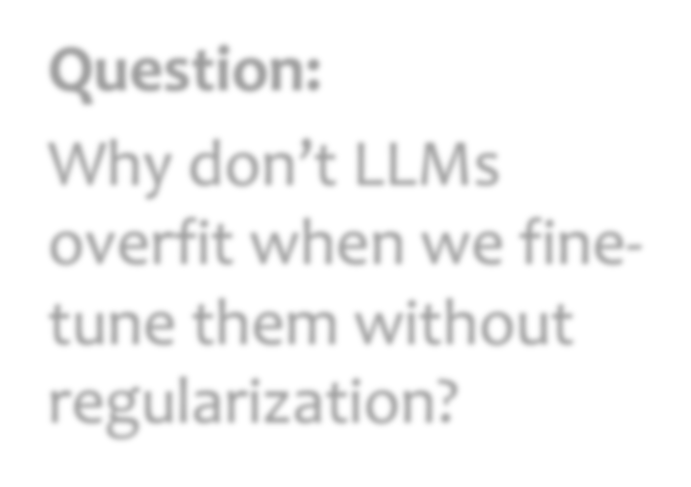

Fine-Tuning LLMs without Regularization
Question:
Why don’t LLMs overfit when we fine- tune them without regularization?
Hypothesis:
They are intrinsically low dimensional

Slide 23
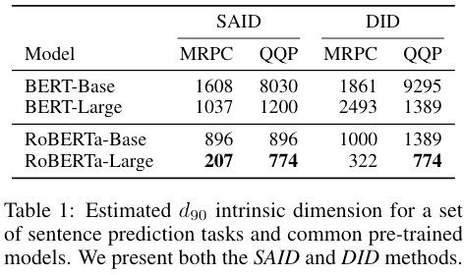
Intrinsic Dimensionality
Using similar techniques, Aghajanyan et al. (2020) measure the intrinsic dimension of LLMs
Empirical results suggest that pre- training finds parameters that have low intrinsic dimensionality
Number of parameters:
  BERT-Base: 110 million
  BERT-Large: 345 million
Figure from http://arxiv.org/abs/1804.08838

Slide 24
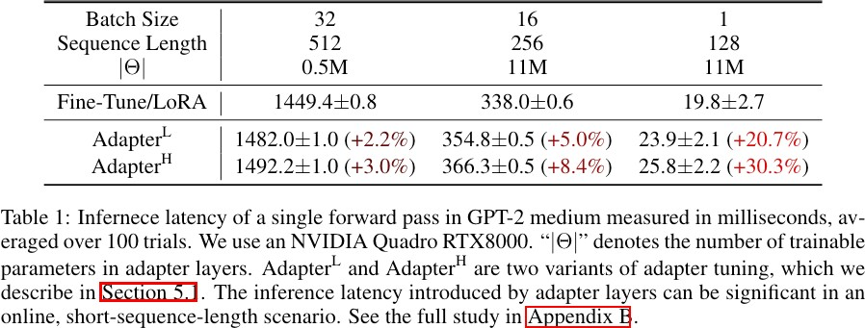
LoRA
Motivation #1:
  “We take inspiration from Li et al. (2018a); Aghajanyan et al. (2020) which show that the learned over-parametrized models in fact reside on a low intrinsic dimension.”
Motivation #2:
  Directly optimizing the prompt, as in prefix tuning, leads to non-monotonic changes in performance as the number of parameters increases (we want more parameters to mean better performance!)
Motivation #3:
  Adapters and related methods introduce inference latency at test time that is non-trivial!

Slide 25
LoRA
Keep the original pretrained parameters W₀ fixed during fine-tuning
Learn an additive modification to those parameters ΔW
Define ΔW via a low rank decomposition:
∆W = BA
where BA has rank r, which is much less than the input dimension k or the output dimension d
Standard Linear Layer
z
z = W₀x
Linear
W₀
W₀ ∈ R
d×k
k
d
, x ∈ R , z ∈ R
x
LoRA Linear Layer
z = W₀x + BAx
= (W₀ + BA)x
d
z
Linear
Linear
B
r
W₀
W₀ ∈ R^{d×k},
A ∈ R^{r×k}, B ∈ R^{d×r}
Linear ^{A}
x
where r << min(d, k)
k
Figure inspired by He et al. (2022)

Slide 26
LoRA
Initialization
We initialize the trainable parameters:
A_{ij} ∼ N (0, σ²), ∀i, j
B = 0
This ensures that, at the start of fine tuning, the parameters have their pretrained values:
∆W = BA = 0
  W0 + BA = W0
Standard Linear Layer
z
z = W₀x
Linear
_{∈ R}d×k
W₀
W
k d
, x ∈ R , z ∈ R
0
x
LoRA Linear Layer
d
z = W x + BAx
0
z
= (W₀ + BA)x
Linear
Linear
B
r
W₀
W₀ ∈ R^{d×k},
A ∈ R^{r×k}, B ∈ R^{d×r}
Linear ^{A}
x
where r << min(d, k)
k
Figure inspired by He et al. (2022)

Slide 27
Overview of PEFT Approaches (LoRA)
Type | R | % Train | 0.01-0.5
Storage | Yes | % Change | 0.5-30
Memory | Yes | <1B | Yes
Backprop | No | <20B | Yes
Inf. Overhead | No | >20B | Yes

Slide 28


LoRA for Transformer
X’
add & layer norm
LoRA linear layers could replace every linear layer in the Transformer layer
But the original paper only applies LoRA to the attention weights
feed-forward neural net
add & layer norm
transformer
Q = LoRALinear(X; W_{q} , A_{q} , B_{q} )
LoRA Linea Layer
d
attention
K = LoRALinear(X; W_{k} , A_{k} , B )
Q
K
V
k
z
V = LoRALinear(X; W_{v} , A_{v} , B_{v} )
multi-headed
⨉
＋
W_{q}
⨉
＋
W_{k}
⨉
＋
W_{v}
Linear
Linear
B
r
W₀
LoRA
LoRA
LoRA
Linear ^{A}
X
x
k
Figure inspired by He et al. (2022)

Slide 29
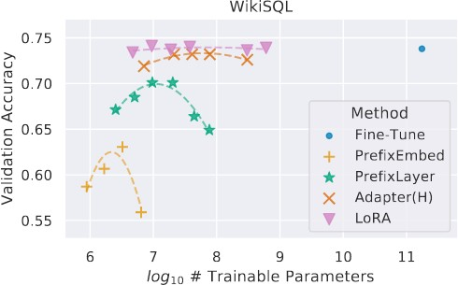
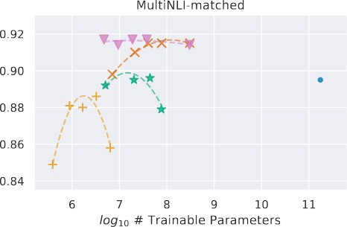
LoRA Results
Takeaways
Applied to GPT-3, LoRA achieves performance almost as good as full fine-tuning, but with far fewer parameters
On some tasks it even outperforms full fine- tuning
For some datasets a rank of r=1 is sufficient

